Slide 1

Java PushbackReader class
PushbackReader is a character-stream reader that allows characters to be pushed back into the stream.
PushbackReader allows you to push back the read characters into the Reader. These characters will then be read again the next time you call read().
The Java PushbackReader works much like the PushbackInputStream except that the PushbackReader works on characters, whereas the PushbackInputStream works on bytes.
PrintStream
Reader(i.e FileReader)
Pushback
PushbackReader
Java Application
Read
Read

Slide 2
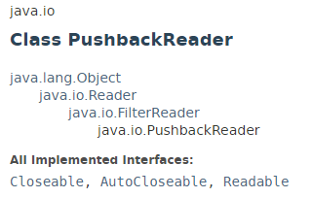
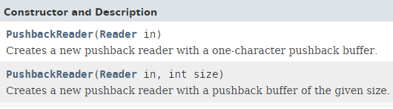
Java PushbackReader class

Slide 3
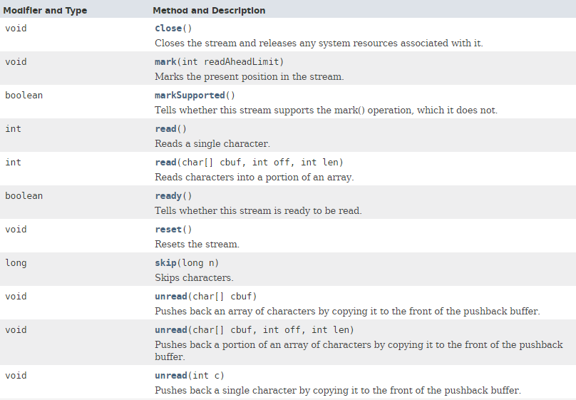
Java PushbackReader class

Slide 4
Java PushbackReader class
https://docs.oracle.com/javase/8/docs/api/index.html?java/io/PushbackReader.html

